Slide 1
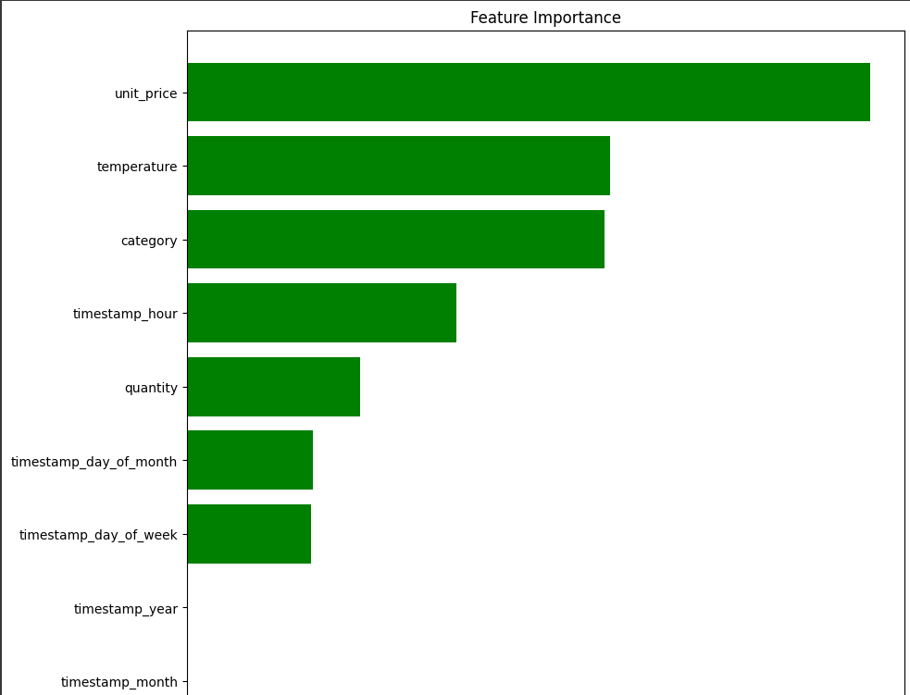
Model Insights
We need more data to make the model efficient while in prediction because we only got poor r2 score .
Feature Importance Insights:
As per visual , the features unit_price,
temperature , category , timestamp_hour ,
gives valuable information while in the
prediction

